Slide 1

HR Analysis
KPI’s , Employee Demographics, Hiring Trends, Employee Turnover and Performance Metrics

Slide 2
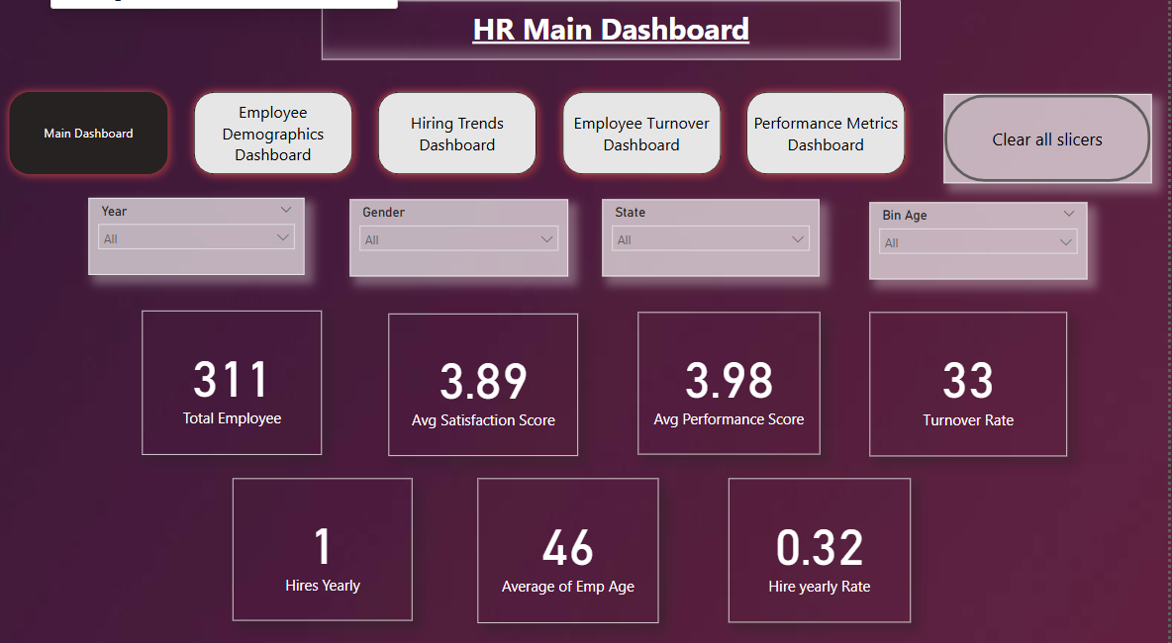
HR Main KPI’s
- Main KPI’s from 2006 to 2018
- Neil Armstrong

Slide 3
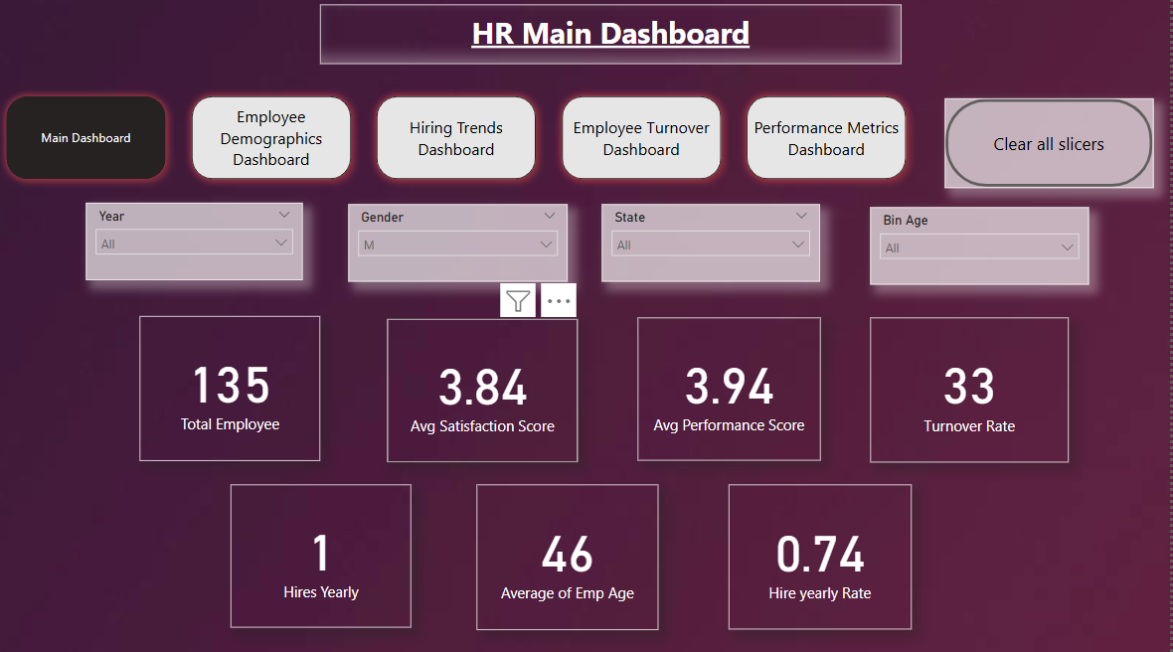
In Male Category

Slide 4
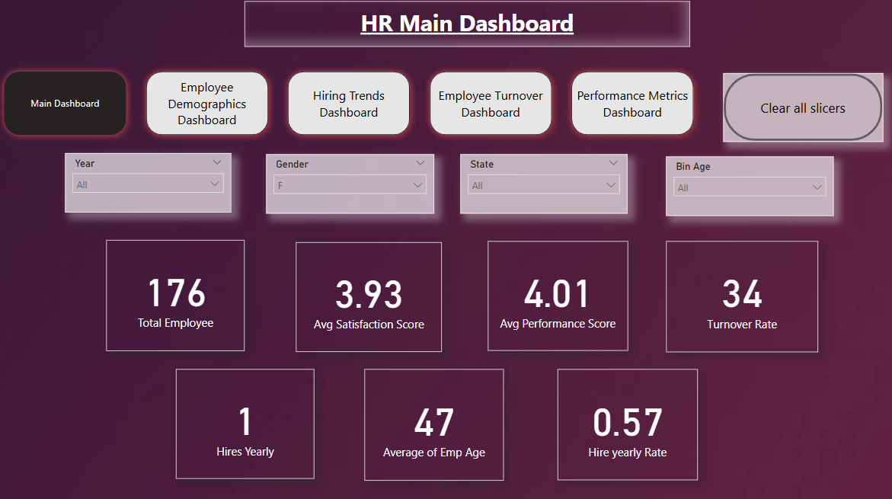
In Female Category

Slide 5
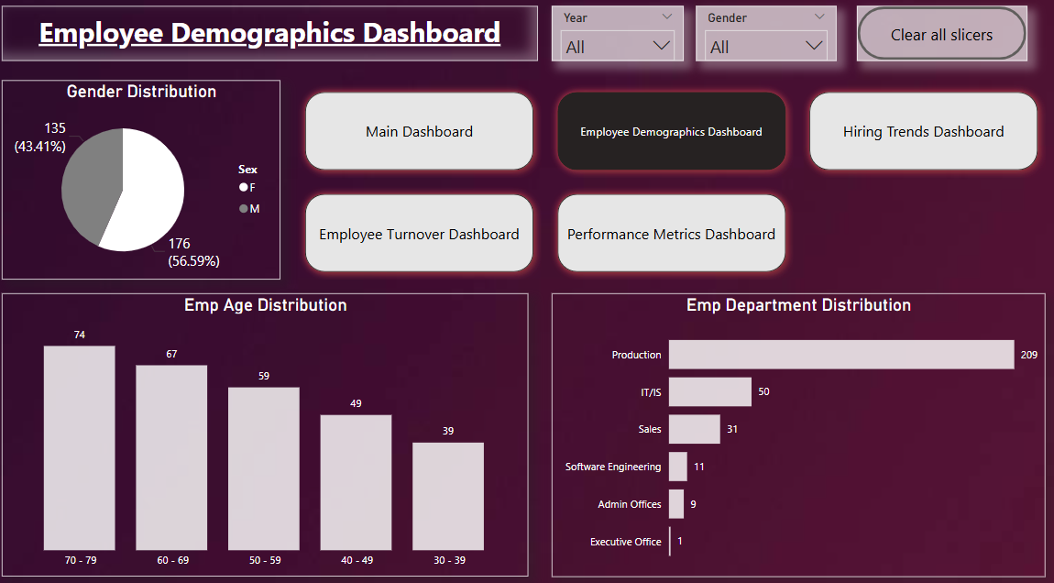
Employee Demographics
- Male are much higher than Female in Gender Distribution

Slide 6
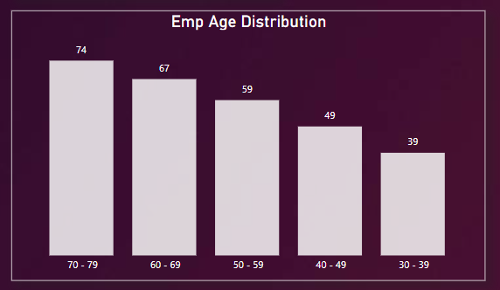
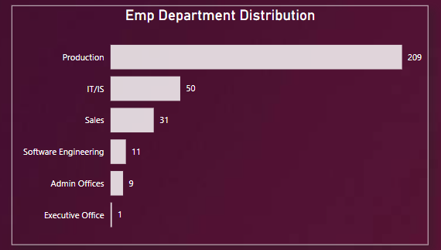
Employee Age and Department Distribution
- As higher age employee is domination in HR distribution.
- Production Department has highest strength while executive office is least distribution out of all employee.

Slide 7
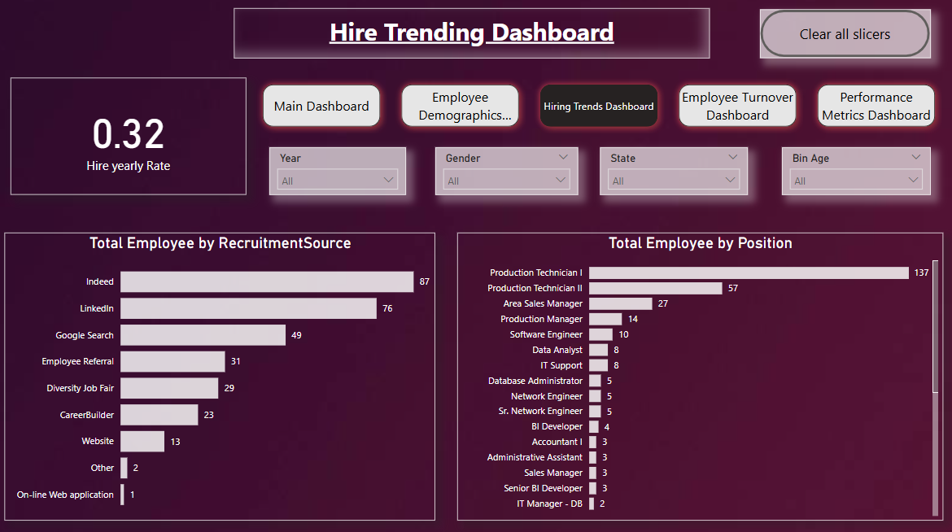
Hiring Trends
Overview of Hiring Trends Dashboard.

Slide 8
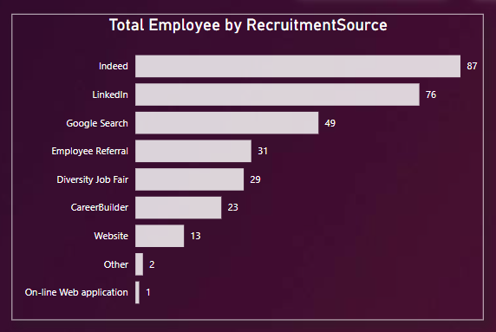
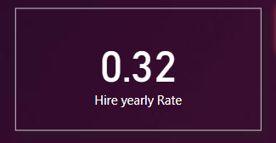
Hiring Trends
Hiring trend is 0.32.
Top 3 Recruitment Source are Indeed, LinkedIn, Google Search

Slide 9
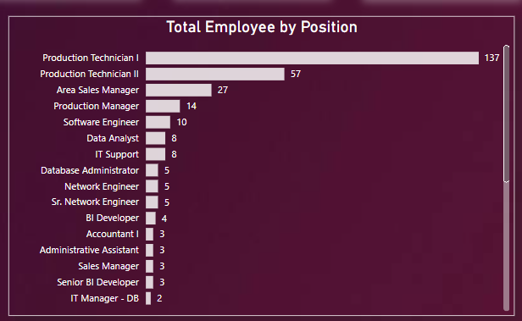
Hiring Job Positions
In Production Technician I and II are top Two position.
Then Area Sale and Production Manager are at rank 3rd and 4^{th.}

Slide 10
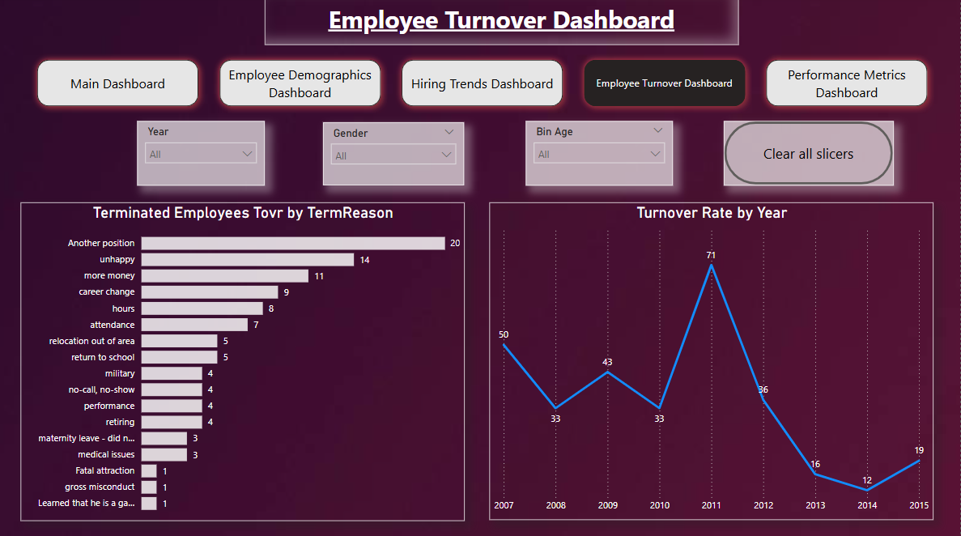
Employee Trunover Ternds
Overview of Employee Turnover Trends

Slide 11
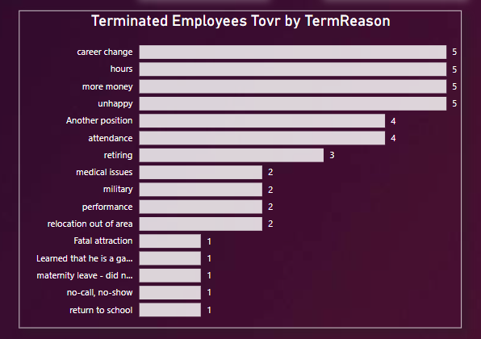
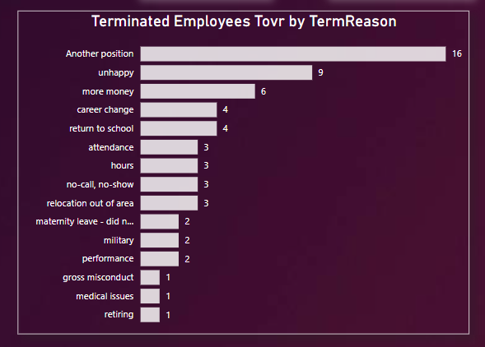
Termination Reason for both Male and Female Category

Slide 12
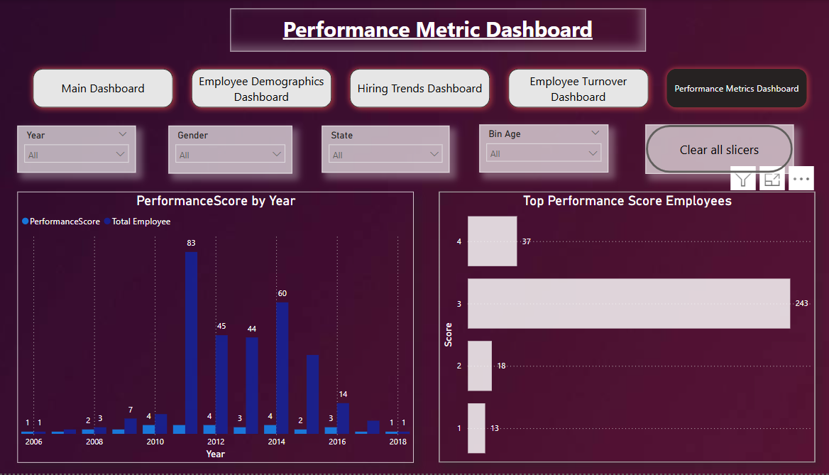
Performance Metrics
Overview of Performance Metrics Dashboard.

Slide 13
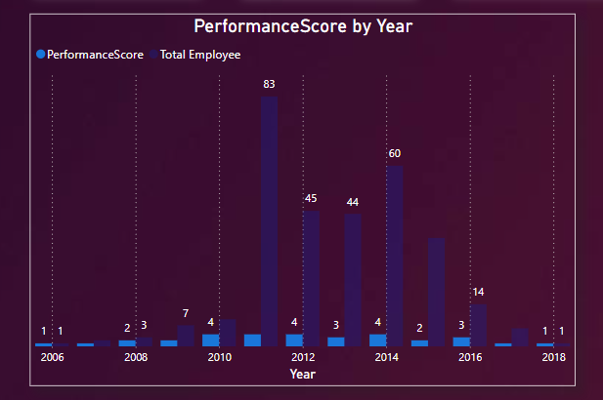
Performance Score and Total employee by year
2011,2014 give higher Performance score. Other is 2012,2014

Slide 14
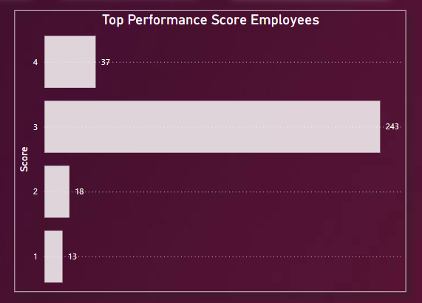
Performance Score of Employees
Performance Score of three(3) are rank 1st.
While Performance score with four(4) at rank 2^{nd.}

Slide 15
Thank You

